Slide 1

ONLINE MOVIE BOOKING SYSTEM

Slide 2
Primary goals
1
2
3
4
5
RELIABILITY
EFFICIENT BOOKING
NO BUGS
SIMPLICITY
FLEXIBILITY

Slide 3

Introduction
"Welcome to our cutting-edge online movie booking system! Powered by Python's Tkinter for seamless user interaction and Oracle SQL for robust data management, our platform offers a streamlined experience for movie enthusiasts. From browsing the latest releases to reserving seats with ease, our system ensures a hassle-free booking process. With intuitive design and efficient database handling, we aim to revolutionize how users engage with cinema entertainment. Join us as we embark on a journey to redefine online movie booking, making it simpler and more enjoyable for everyone."

Slide 4
REQUIREMENTS 1. Python (with Tkinter) installation for frontend development. 2. Oracle SQL database setup for backend data storage. 3. Integration of Tkinter GUI with Oracle SQL for seamless user experience. 4. Implementation of booking algorithms for seat reservation and management.
“
”

Slide 5
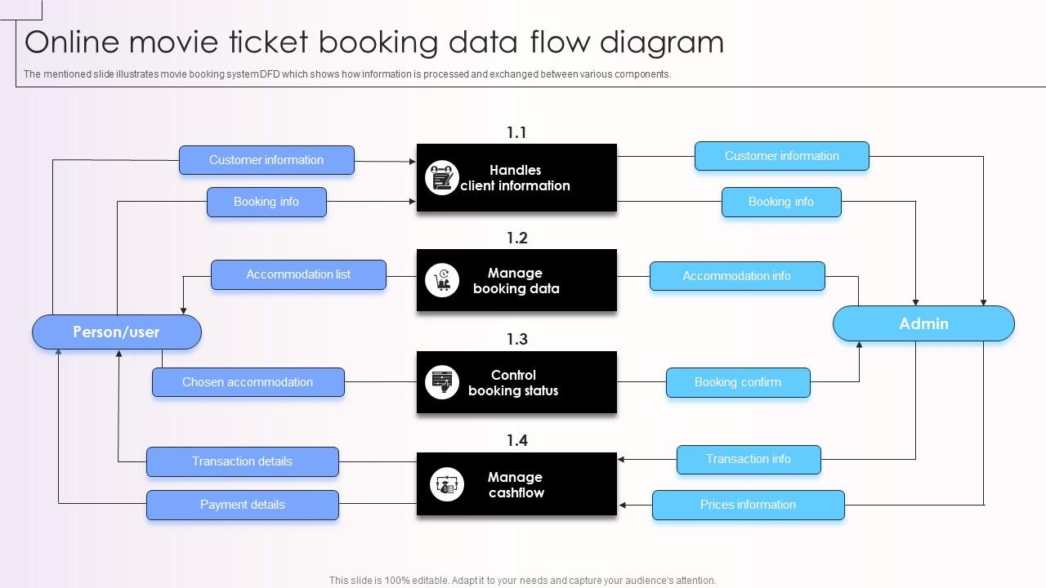
DATA FLOW DIAGRAM

Slide 6
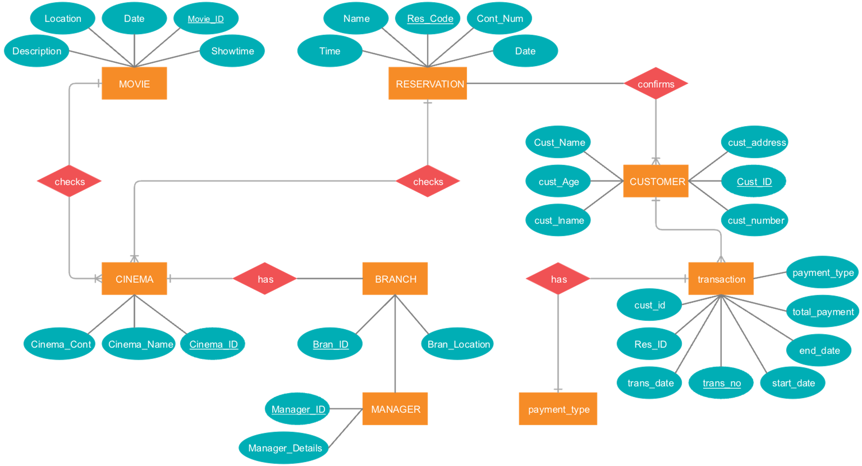
ER DIAGRAM

Slide 7

Summary
In conclusion, our online movie booking system built with Python Tkinter and Oracle SQL offers a user-friendly interface and robust backend functionality. Through seamless integration of Tkinter GUI with Oracle SQL, users can effortlessly browse movies, select theaters, and reserve seats. The system's efficient booking algorithms ensure smooth seat management and reservation processes. With intuitive design and reliable database handling, we aim to provide an unparalleled movie booking experience for users.

Slide 8

Thank you
BY :
SEENUVAASAN
SAFEEKUR RAHMAN

